Slide 1


Meet Hadrian: a new build system for GHC
Andrey Mokhov, Neil Mitchell, Simon Peyton Jones, Simon Marlow

Slide 2
Part I: Why new build system?
$1/$2/build/%.$$($3_osuf) : $1/$4/%.hs $$(LAX_DEPS_FOLLOW) \
$$$$($1_$2_HC_DEP) $$($1_$2_PKGDATA_DEP)
$$(call cmd,$1_$2_HC) $$($1_$2_$3_ALL_HC_OPTS) -c $$< -o $$@ \
$$(if $$(findstring YES,$$($1_$2_DYNAMIC_TOO)), \
-dyno $$(addsuffix .$$(dyn_osuf),$$(basename $$@)))
$$(call ohi-sanity-check,$1,$2,$3,$1/$2/build/$$*)
$19 per line!

Slide 3
Problem 1: Variables and macros
Make uses a global namespace of mutable string variables
Numbers, arrays, associative maps are encoded in strings
No encapsulation and implementation hiding
Variable references are spliced into Makefiles and interpreted, so special characters like space and colon cause havoc
To expand a variable use $; to get $ use $$; to get $$ use $$$$…
Solution: use any modern programming language instead
We use Shake – a Haskell library for writing build systems

Slide 4
Shake library in one slide
%.o : %.c
gcc $CC_OPTS $<
Make:
(%>) :: FilePattern -> (FilePath -> Action ()) -> Rules ()
"*.o" %> \out -> do
let src = out `replaceExtension` "c"
need [src]
cmd "gcc" ccOpts [src]
Shake:
need :: [FilePath] -> Action ()
cmd :: CmdArguments args => args :-> Action r

Slide 5
Problem 2: Dynamic dependencies
Make uses a static dependency graph
But GHC dependency graph is dynamic:
Sources contain import and #include statements
GHC package dependencies are stored in .cabal files
Many files are generated
Poor solution: use build phases
Solution: use Shake’s monadic dependencies
Discover dependency graph during the build

Slide 6
Problem 3: Build rules with multiple outputs
Typical way to express multiple outputs in Make:
Fragile: if we delete the interface file, it won’t be restored.
%.o : %.hs
ghc $HC_OPTS $<
%.hi : %.o ;
Solution: use Shake‘s multiple output build rules
["∗.o", "∗.hi"] &%> \[o, hi] -> do ...

Slide 7
Problem 4: Concurrency reduction
GHC packages need to be registered by invoking ghc-pkg
ghc-pkg mutates the global state (package database)
Hence at most one package can be registered at a time
Poor solution: use concurrency reduction dependencies
Fragile (easy to get the order of package registration wrong)
Inefficient (reduces parallelism too much)
Solution: use Shake’s resources
packageDb <- newResource "package-db" 1
action $ withResource packageDb 1 $ cmd "ghc-pkg" ...

Slide 8
Problem 5: Fine-grain dependencies
GHC uses Autoconf to generate various configuration settings:
Everything depends on this file transitively, and even if a single line changes, Make will rebuild all GHC.
Poor solution: use a separate file for each configuration setting.
alex = /usr/local/bin/alex
ar = /mingw64/bin/ar
ar-supports-at-file = YES
Solution: use Shake’s polymorphic dependencies to depend on individual configuration settings.

Slide 9
Problem 6: Computing command lines
Build command lines introduce a lot of complexity, e.g.:
Hard to extend: file-specific flags require WAY_p_file_HC_OPTS
WAY_p_HC_OPTS = -static –prof
...
base_stage1_HC_OPTS = -this-unit-id base
...
$1_$2_$3_HC_OPTS = $$(WAY_$3_HC_OPTS) \
$$($1_$2_HC_OPTS) \
...plus 30 more configuration patterns
Solution: develop an EDSL for computing command lines.

Slide 10
More details
Shake:
N. Mitchell: “Shake before building – replacing Make with Haskell”, ICFP 2012
http://shakebuild.com/
Hadrian:
A. Mokhov, N. Mitchell, S. Peyton Jones, S. Marlow: “Non-recursive Make Considered Harmful: Build Systems at Scale”, Haskell Symposium 2016
https://github.com/snowleopard/hadrian

Slide 11
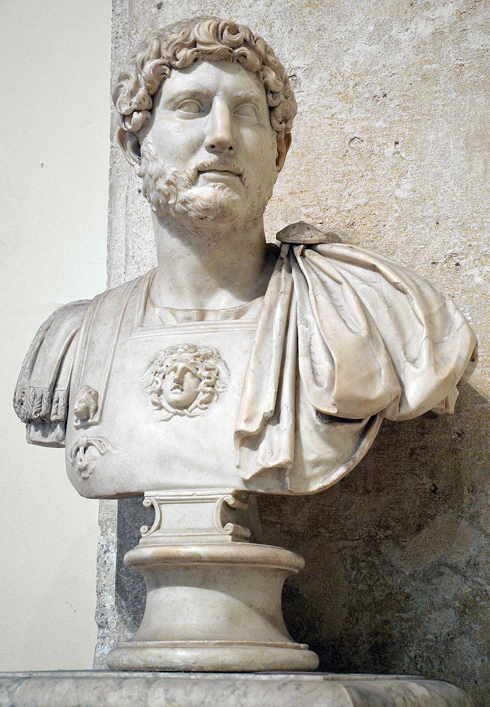
Part II: Introduction
to Hadrian

Slide 12
Package
GHC source code is split into logical units, or packages.
data PackageType = Library | Program
data Package = Package
{ pkgName :: PackageName
, pkgPath :: FilePath
, pkgType :: PackageType }
base = library "base"
genprimopcode = utility "genprimopcode"

Slide 13
Way
A package can be built multiple ways, e.g. with profiling information, for multithreaded execution, etc.
newtype Way = ... deriving Eq
vanilla, profiling, threaded, ... :: Way
osuf vanilla = "o"
osuf profiling = "p_o"
osuf threaded = "thr_o"
...

Slide 14
Stage
Each package can be built by several versions of GHC:
In Stage0 we use the bootstrap GHC to build stage 1 GHC
In Stage1 we use stage 1 GHC to build stage 2 GHC (our goal)
In Stage2 we use stage 2 GHC to build stage 3 GHC (self-test)
data Stage = Stage0 | Stage1 | Stage2 | Stage3

Slide 15
Context
Stage, Package and Way form a GHC-specific build context.
data Context = Context
{ stage :: Stage
, package :: Package
, way :: Way }

Slide 16
Builder
Hadrian invokes external builders, such as compilers, linkers, etc.
data GhcMode = CompileHs | LinkHs | ...
data Builder = Alex
| Ar
| GenPrimopCode
| Ghc GhcMode Stage
| Haddock
| Happy
| ... (plus 20 more)
builderPath :: Builder -> Action FilePath

Slide 17
Target
Each invocation of a builder is fully described by a target.
data Target = Target
{ context :: Context
, builder :: Builder
, inputs :: [FilePath]
, outputs :: [FilePath] }
preludeTarget = Target
{ context = Context Stage1 base profiling
, builder = Ghc Stage1
, inputs = ["libraries/base/Prelude.hs"]
, outputs = ["build/stage1/libraries/base/Prelude.p_o"] }

Slide 18
Computing command line for a target
Given preludeTarget how to compute the build command for it?
preludeTarget = Target
{ context = Context Stage1 base profiling
, builder = Ghc Stage1
, inputs = ["libraries/base/Prelude.hs"]
, outputs = ["build/stage1/libraries/base/Prelude.p_o"] }
commandLine :: Target -> Action [String]
inplace/bin/ghc-stage1 -O2 -prof -c libraries/base/Prelude.hs
-o build/stage1/libraries/base/Prelude.p_o

Slide 19
Expression
An expression Expr a is a computation that produces a value of type Action a and can read the current build Target:
type Expr a = ReaderT Target Action a
ghcArgs :: Expr [String]
ghcArgs = do
target <- ask
return $ [ "-O2" ]
++ [ "-prof" | way (context target) == profiling ]
++ [ "-c", head (inputs target) ]
++ [ "-o", head (outputs target) ]

Slide 20
Predicate
To make conditionals concise we use predicates of type Expr Bool
type Predicate = Expr Bool
way :: Way -> Predicate
way w = do
target <- ask
return $ Context.way (context target) == w
stage :: Stage -> Predicate
package :: Package -> Predicate
builder :: Builder -> Predicate
input, output :: FilePattern -> Predicate

Slide 21
Predicate
Predicates can make expressions conditional using operator (?)
(?) :: Monoid a => Predicate -> Expr a -> Expr a
predicate ? expr = do
bool <- predicate
if bool then expr else return mempty
prof :: Expr [String]
prof = way profiling ? return ["-prof"]
instance Monoid a => Monoid (Expr a) where
mempty = return mempty
mappend = liftM2 mappend

Slide 22
Modifiable Expression
Expressions need to be modifiable by users of Hadrian. We need a way not only to add new build arguments, but also remove them. Idea: switch to difference list expressions Expr (Diff a):
newtype Diff a = Diff { fromDiff :: a -> a }
instance Monoid (Diff a) where
mempty = Diff id
mappend (Diff x) (Diff y) = Diff $ y . X
type Args = Expr (Diff [String])

Slide 23
Modifiable Expression
Appending and removing items to/from a difference list:
append :: Monoid a => a -> Expr (Diff a)
append x = return $ Diff (<> x)
remove :: Eq a => [a] -> Expr (Diff [a])
remove xs = return . Diff $ filter (`notElem` xs)
arg :: String -> Args
arg = append . return

Slide 24
Modifiable Expression
Example:
ghcArgs :: Args
ghcArgs = builder Ghc ? mconcat
[ arg "-O2"
, way profiling ? arg "-prof"
, arg "-c", arg =<< getInput
, arg "-o", arg =<< getOutput ]
args :: Args
args = mconcat [ ghcArgs, ..., userArgs ]

Slide 25
Building a target
To build a target we compute the command line using Args reader.
build :: Target -> Action ()
build target@Target {..} = do
path <- builderPath builder
need [path]
checkArgsHash target
argList <- runArgs target args
cmd [path] argList

Slide 26
Current limitations
We can build stage 2 GHC, but still lack many features:
We only build vanilla and profiling way
Validation is not implemented
Only HTML Haddock documentation is supported
Not all build flavours are not supported
Cross-compilation is not implemented
No support for installation or binary/source distribution
46 open issues: https://github.com/snowleopard/hadrian/issues

Slide 27
Experiments
Qualitative analysis:
We studied 11 common use-cases of GHC build system, such as “edit a source file and rebuild”, “add a new build command line argument and rebuild”, “git branch and rebuild”, etc.
The old build system performs a lot of unnecessary rebuilds in many cases, whereas Hadrian correctly handles most cases.
Quantitative benchmarks: Hadrian is faster
Zero build: 2.2s vs 2.0s (Linux), 12.3s vs 2.1s (Windows)
Full build: 649s vs 578s (Linux), 1266s vs 737s (Windows)

Slide 28
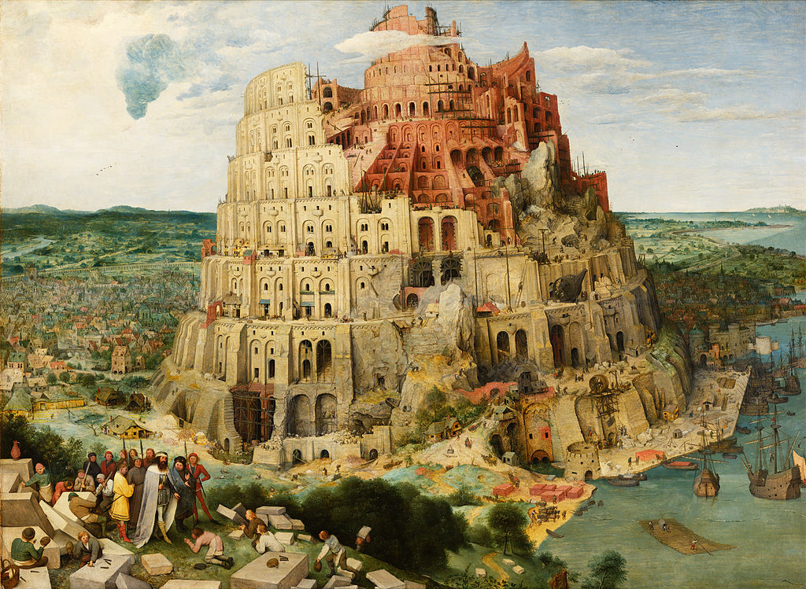
Build GHC

